Slide 1
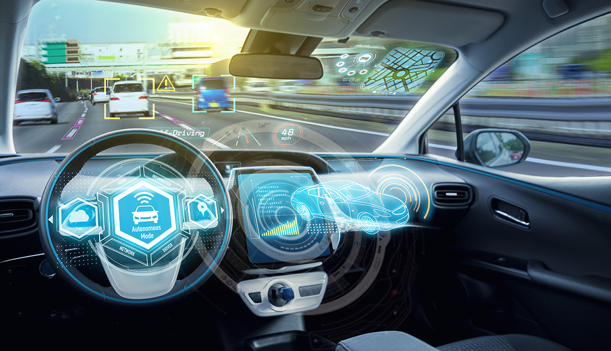
Predicting vehicles’ position and angles from single image of road using Deep-Learning

Slide 2
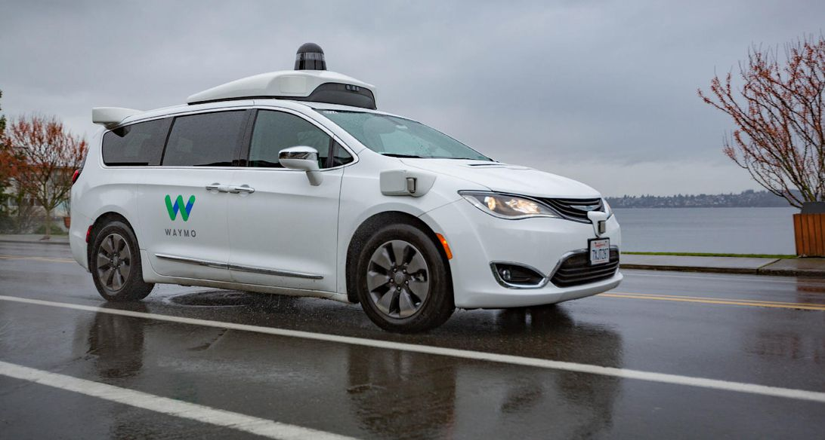
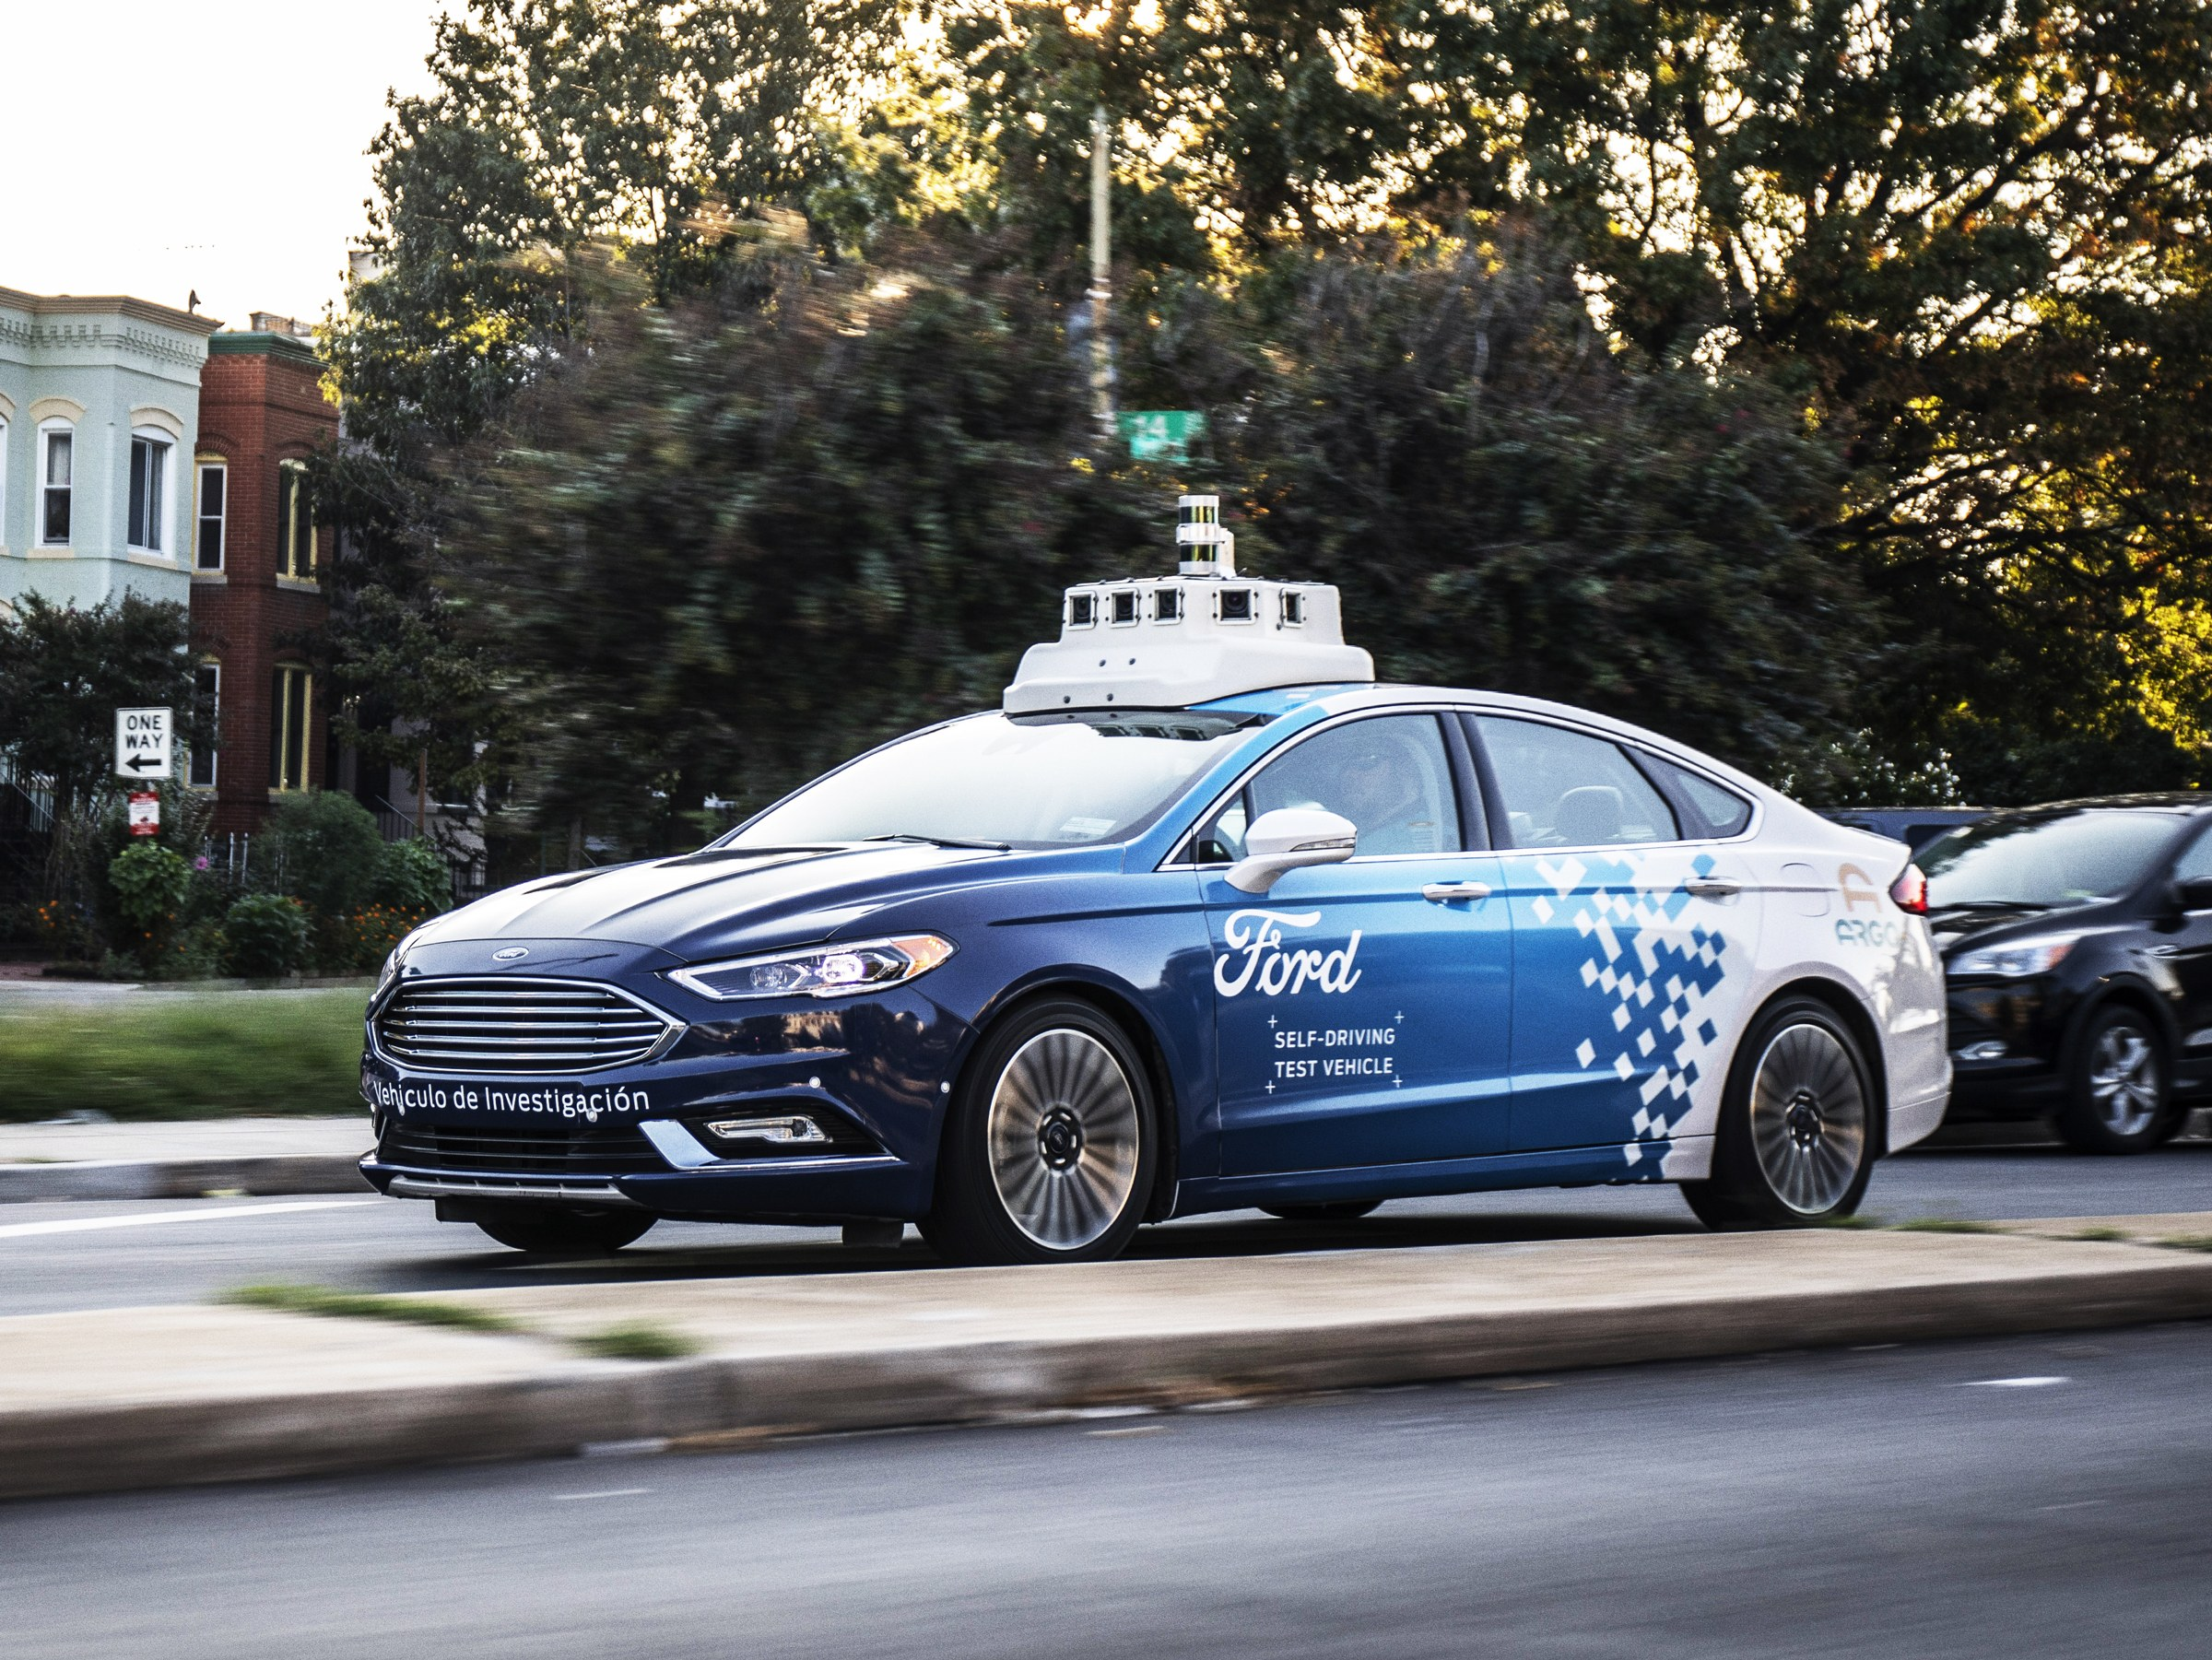
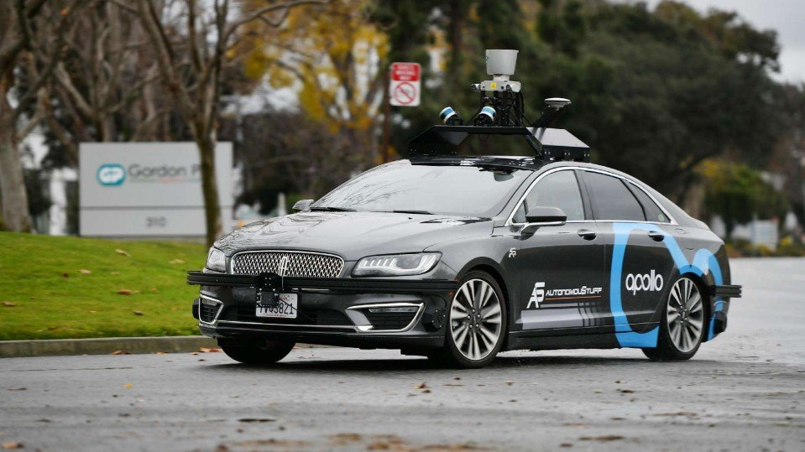
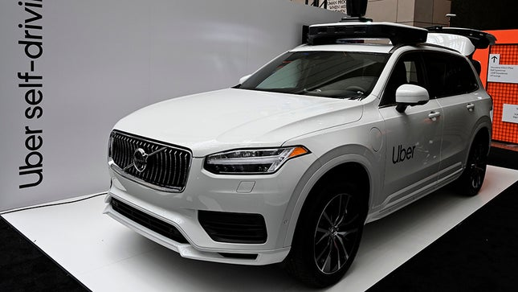
Notes:
How many of you have seen this vehicles on road? Why aren’t they common?

Slide 3
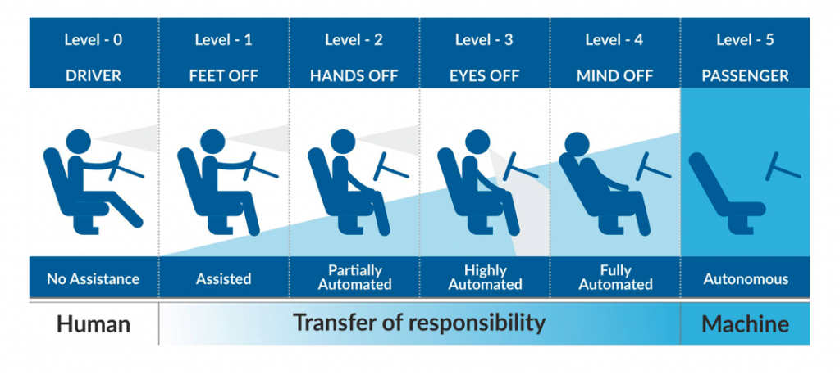
Notes:
SAE published these levels of automation, no one lies in level 5. Waymo is atmost level 4 for being fully automated in Phoenix

Slide 4
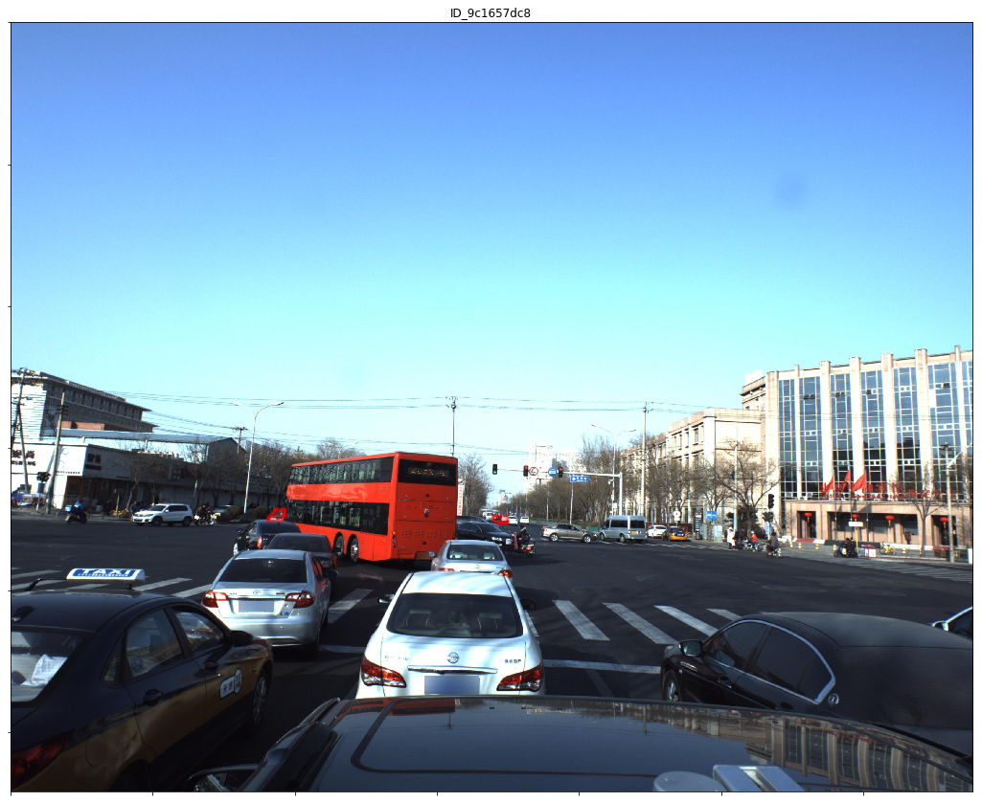
Predict Other Vehicles’ Position and Angle
Data: Labelled Road image from a car’s dash cam with masks
Target: yaw, pitch, roll, x, y, z, confidence factor

Slide 5
Our Approach
Data Preprocessing Mask / Clean
Detection
Detect Objects (Car) using YOLO or ResNet, Extract them
Prediction
CNN mapping from Car Image to Position, Angle Prediction

Slide 6
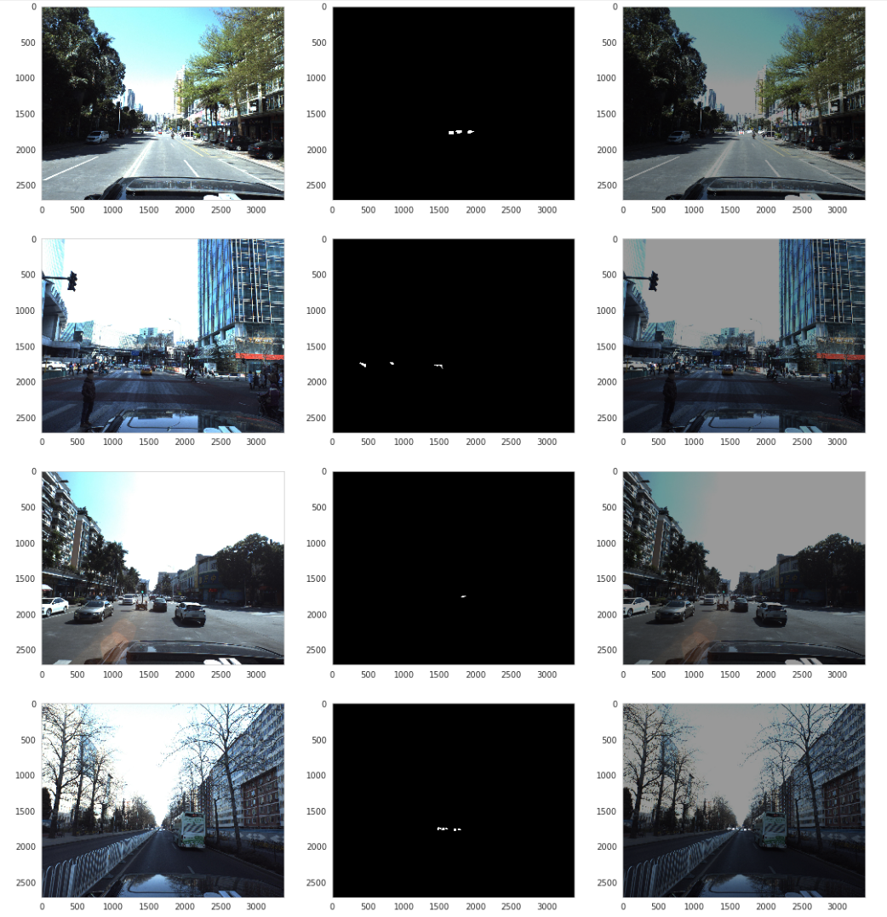
Data Preprocessing Masking

Slide 7
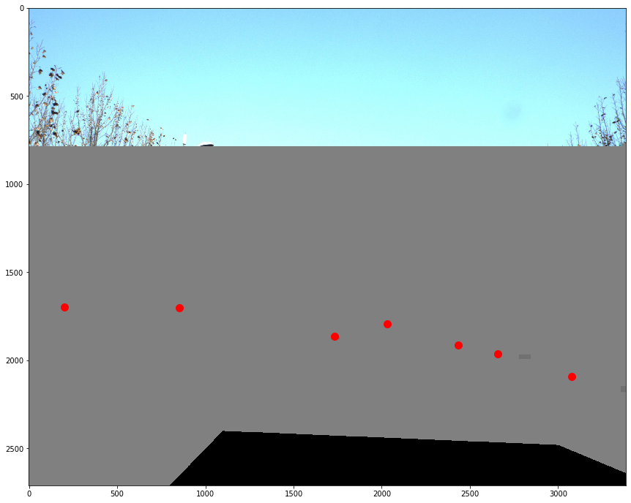
Data Preprocessing (Remove Bad Examples – Found through a detection analysis)
Notes:
Also masking the bonnet, as detector in our next step was considering our own car as an object too, which is although right but we are not interested to know that in this problem.

Slide 8
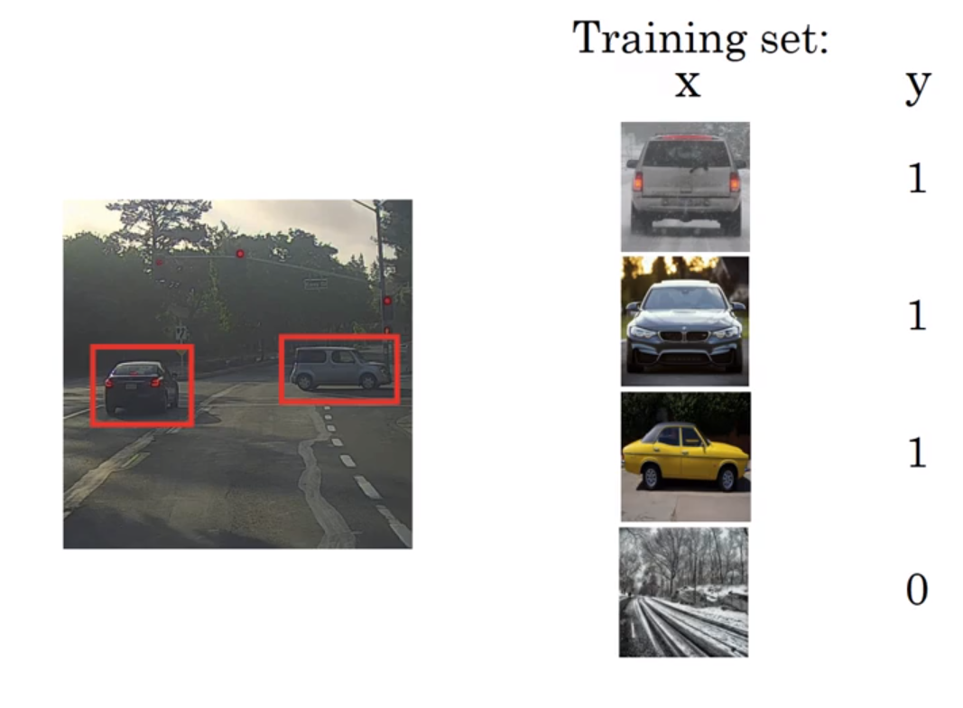
Object Detection
Notes:
Image Classification
Image Classification with Localization
Object Detection – Sliding Window Detection (Deformable Parts Model)

Slide 9
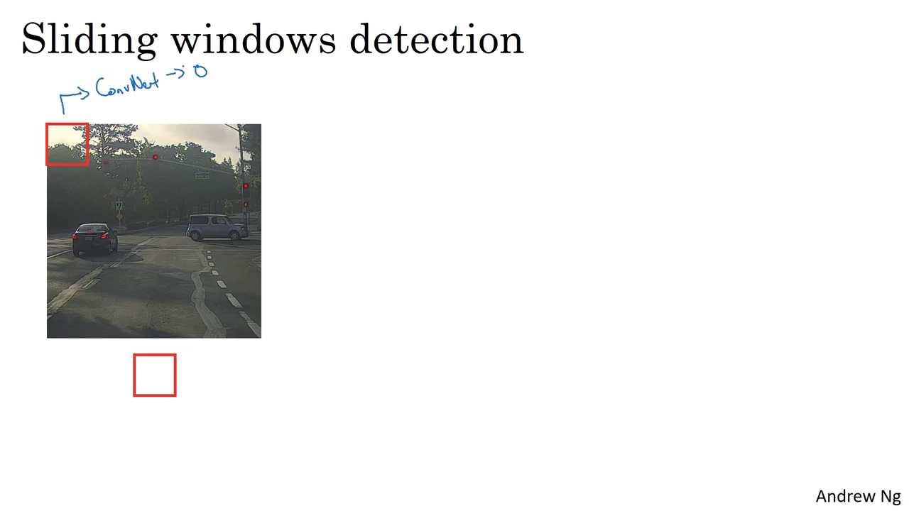
Object Detection
Notes:
This is really slow computationally as the window slides every pixel and a lot of passes are made at similar regions which already may not be useful. We could use strides but then it becomes a tradeoff between coarse granularity and computational expense.

Slide 10
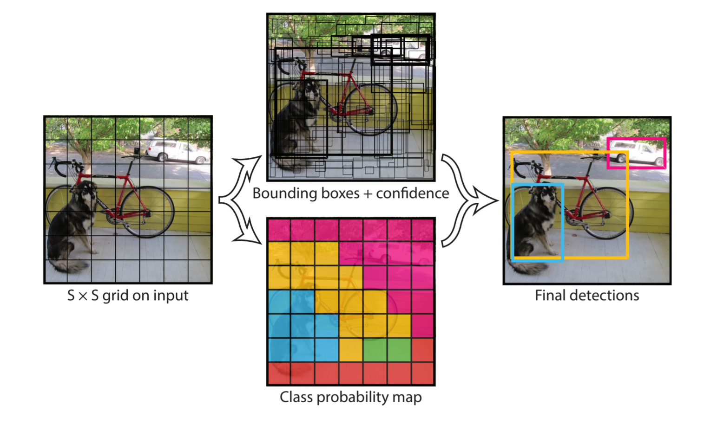
YOLO Brief Overview

Slide 11
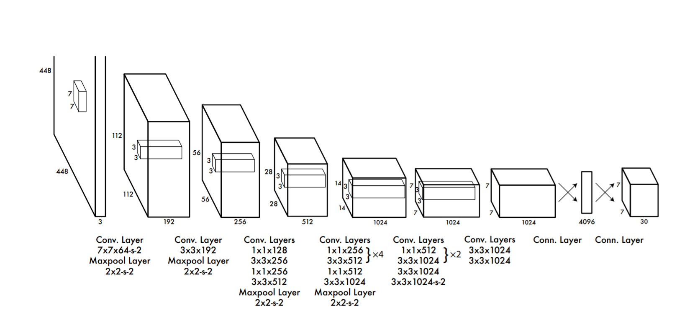
YOLO Brief Overview
Notes:
It has 24 convolutional layers followed by 2 fully connected layers. This is the very basic version of YOLO, v1.
We used YOLO v3 which is a bit more complex and has around 106 layers, makes use of residual blocks.
It has outperformed SSD and RetinaNet (Has Regional Mapping, Built on top of ResNet which had 152 layers).

Slide 12
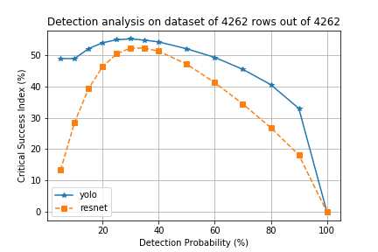
Detector Analysis

Slide 13
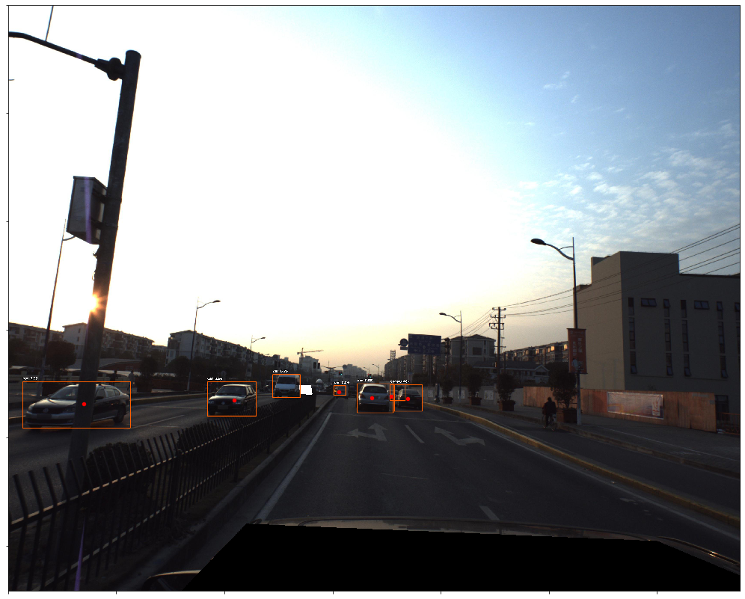
Detector (Example has 1 FP)

Slide 14
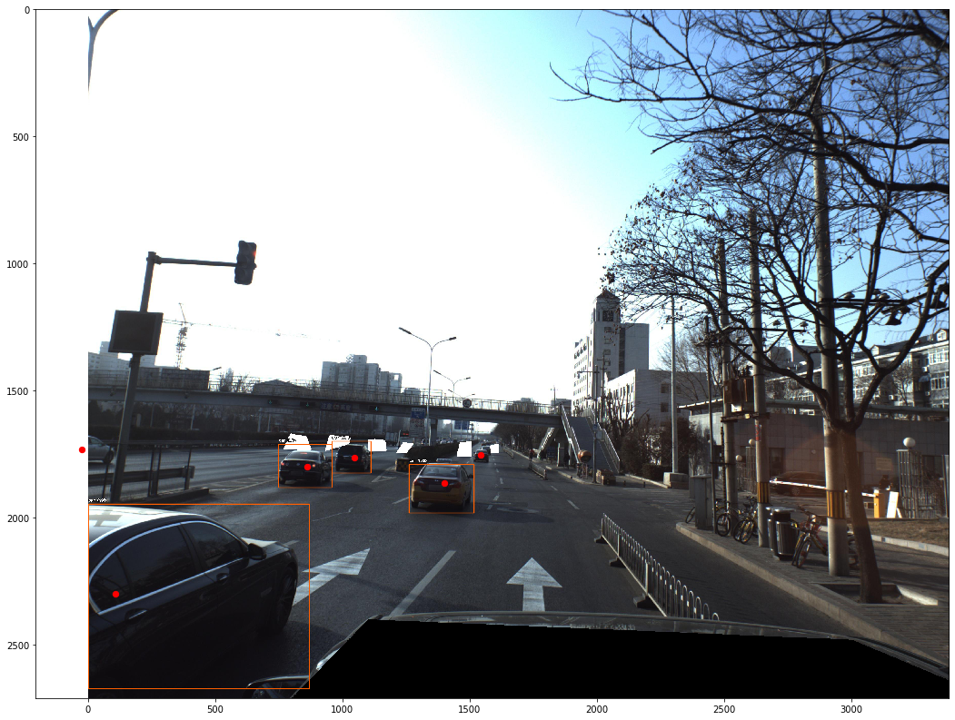
Detector (Example has 2 FN)

Slide 15
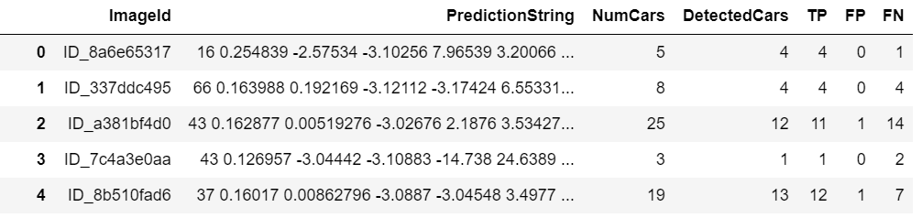
Detector Analysis

Slide 16
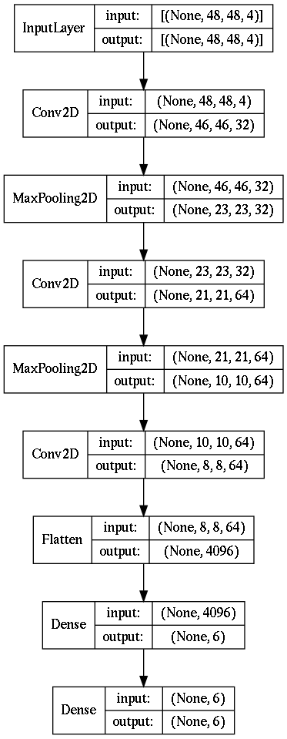
Prediction Stage (CNN Model)

Slide 17
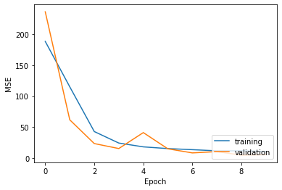
Prediction Stage Learning Curve

Slide 18
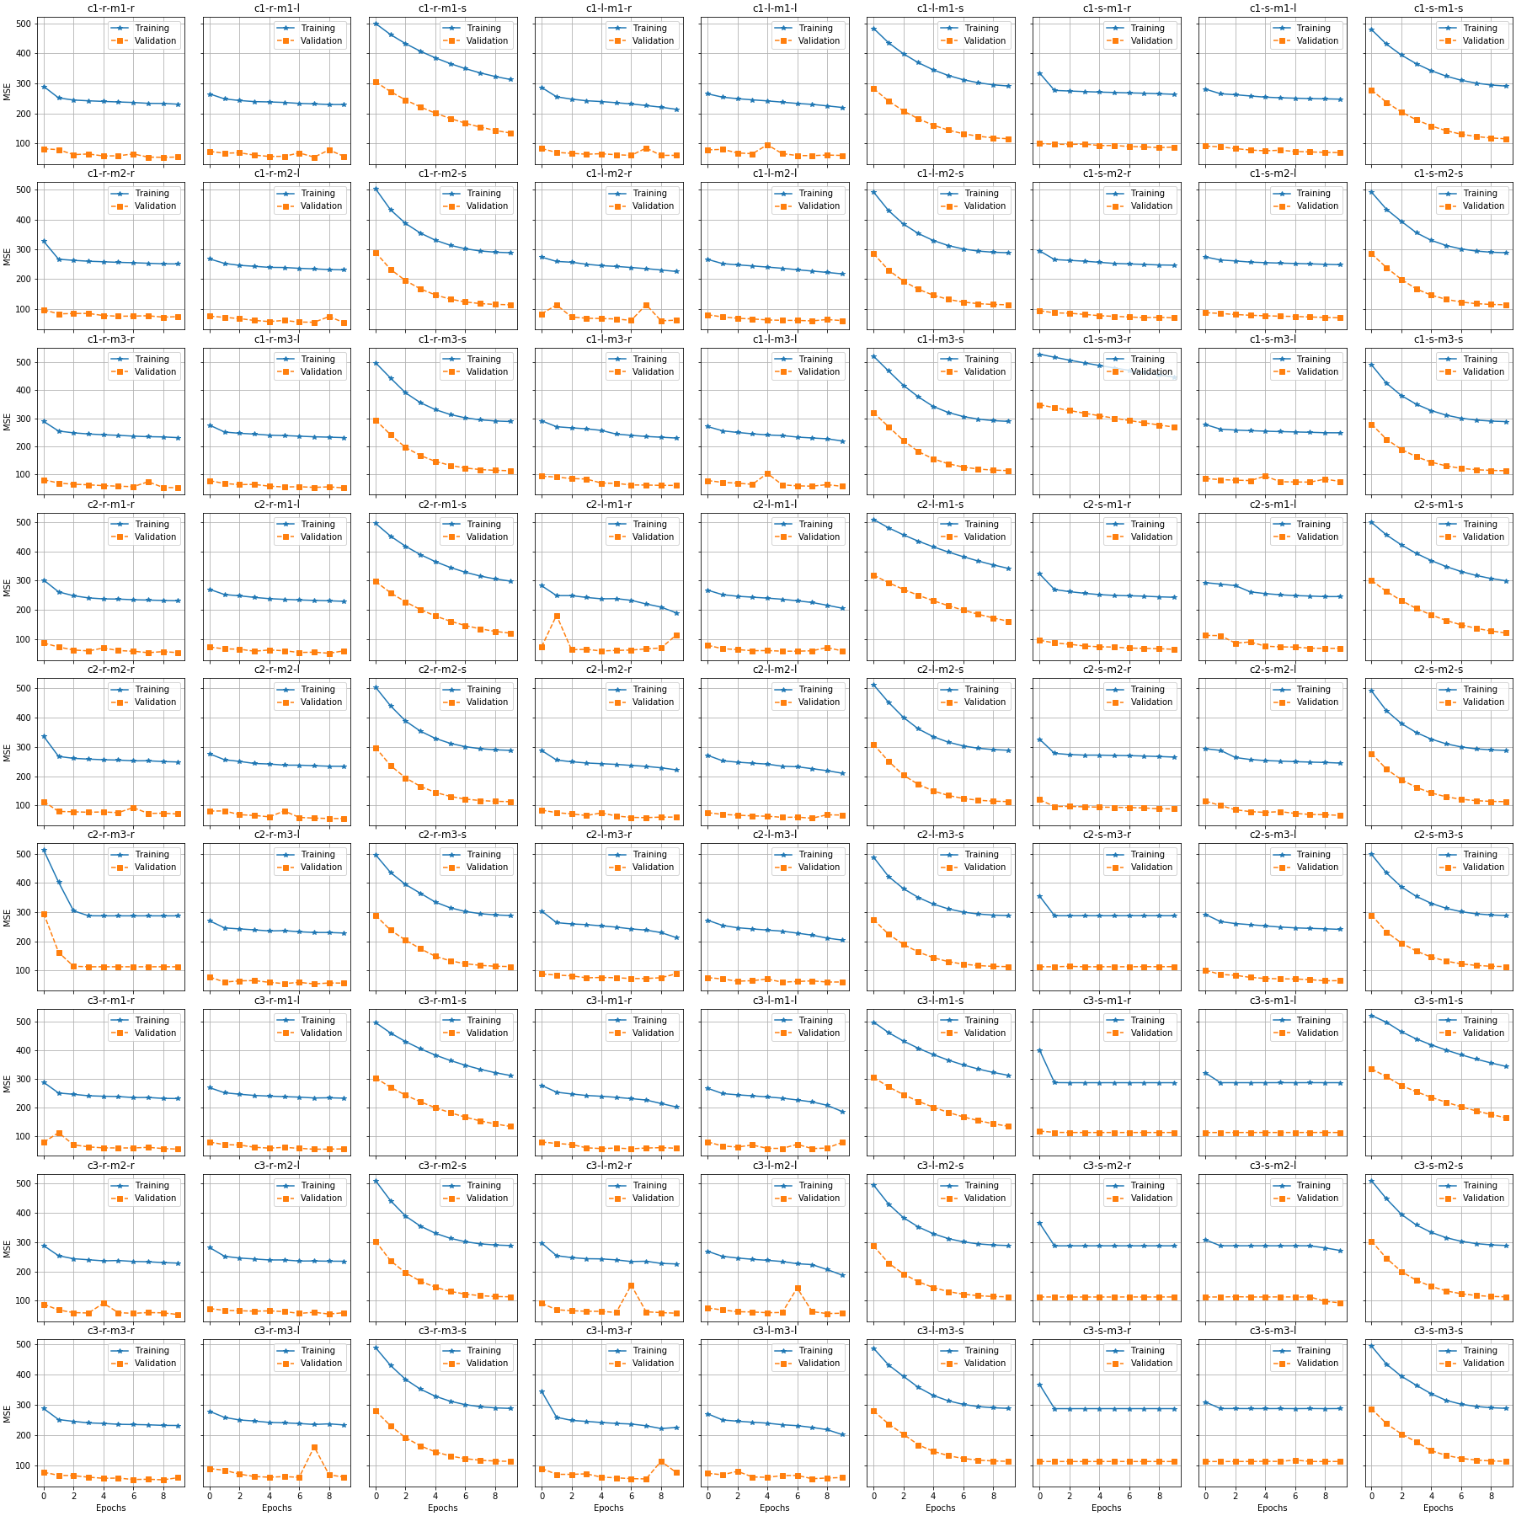
Grid Search on finding best hyperparameters of CNN Model (Prediction Stage)

Slide 19
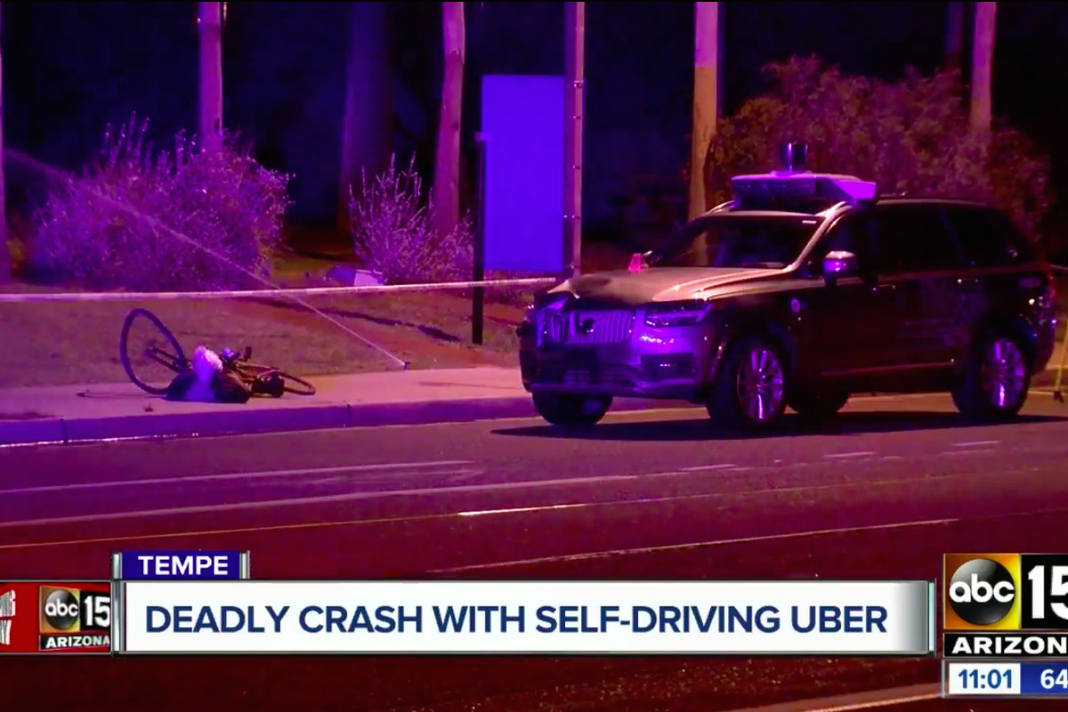
“As the [automated driving system] changed the classification of the pedestrian several times—alternating between vehicle, bicycle, and an other— the system was unable to correctly predict the path of the detected object,” NTSB Report in May 2018

